Slide 1

Wajdi Ben Saad
Sept ,2015
Notes:
Wajdi Ben Saad

Slide 2
About This course
10 weeks ~ 8 classes to attend
(VERY) Project oriented
Pair project assignments
Evaluation based on homework assignments

Slide 3
To Do for the first 2 weeks
Class Emails (preferably Gmail )
Mine is :
wajdi.ben.saad@gmail.com

Slide 4
First Challenge !
Installing SAS 9.2 or 9.3 on your machines
(There is a portable version you can use if nothing else works)
Do the first assignment sent to you by Email
PS: I Can’t / Wont help you with that!

Slide 5
What is SAS?
Began as a statistical package
Also allows users to:
  Store data
  Manipulate data
  Create reports
    PDF
    Excel
    HTML
    XML
    RTF / Word
    Etc. Etc. Etc.
Notes:
Wajdi Ben Saad

Slide 6
What is SAS?
Also allows users to:
  Create graphs
  Create maps
  Send e-mails
  Create web applications
  Create iPhone Apps
  Access R
  Schedule regularly run reports
  Etc. Etc. Etc.

Slide 7
SAS DISPLAY MANAGER

Slide 8
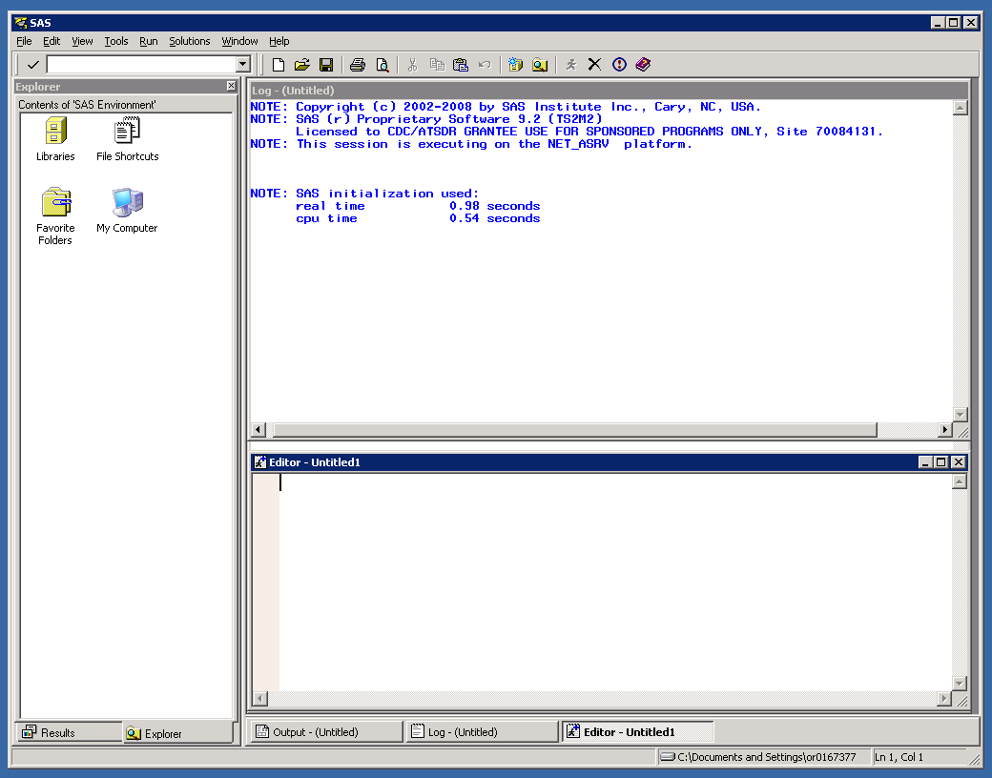
Log:
Details about jobs you’ve run, including error messages
Explorer Window:
See libraries and SAS datasets
Enhanced Editor:
Where you write your SAS code

Slide 9
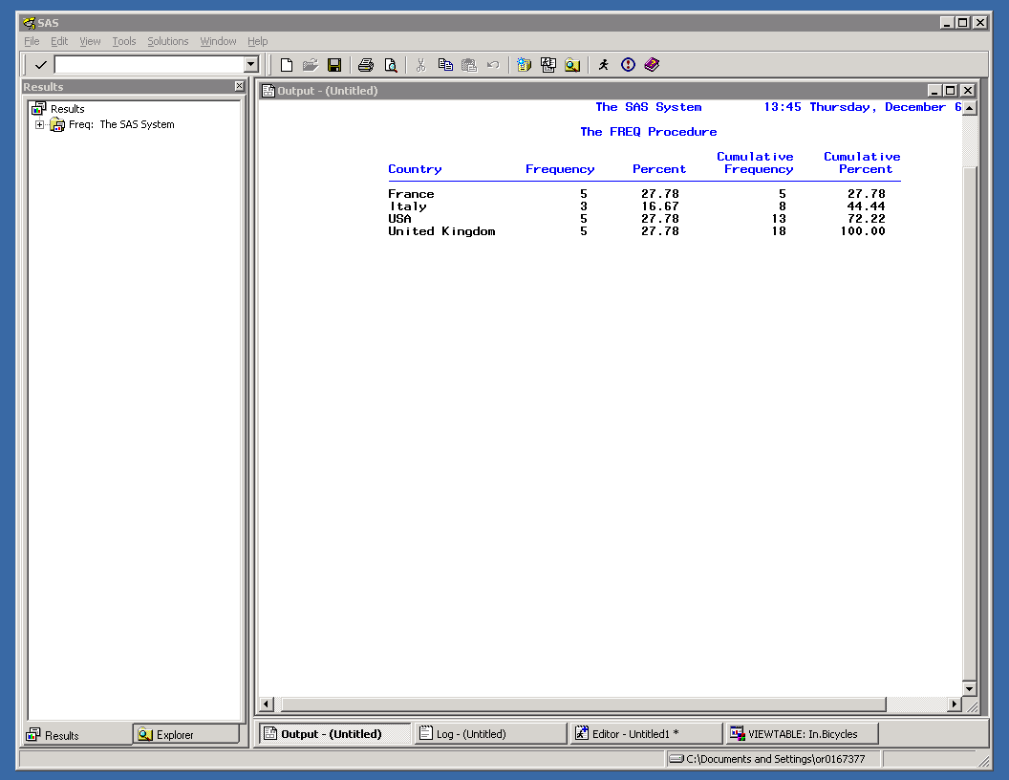
Results tab:
List of previously run results
Output Window:
Basic view of results and output
(Also known as “Listing Destination”)

Slide 10
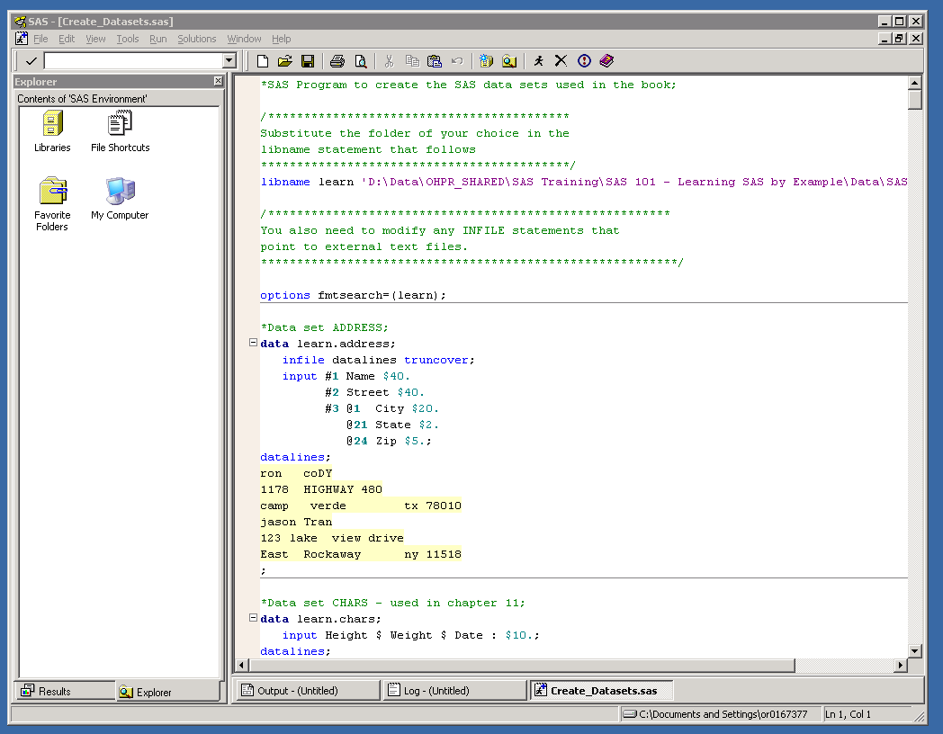
Run:
Submits your SAS code
(“The Running Man”)

Slide 11
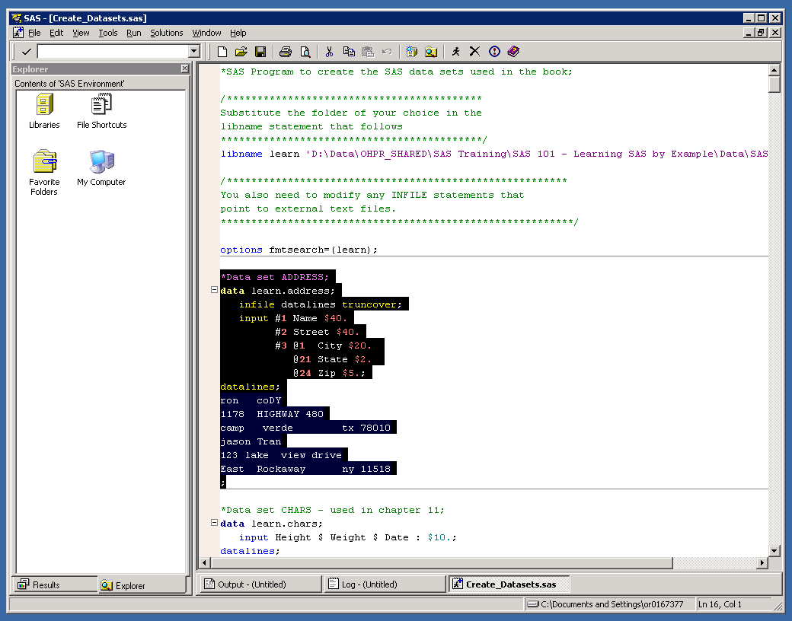
You can submit the program as a whole
or
Run only a portion of highlighted code

Slide 12
Chunks of code will be processed in the order you RUN them, not necessarily in the order you wrote them

Slide 13
THE ELEMENTS OF A SAS PROGRAM

Slide 14
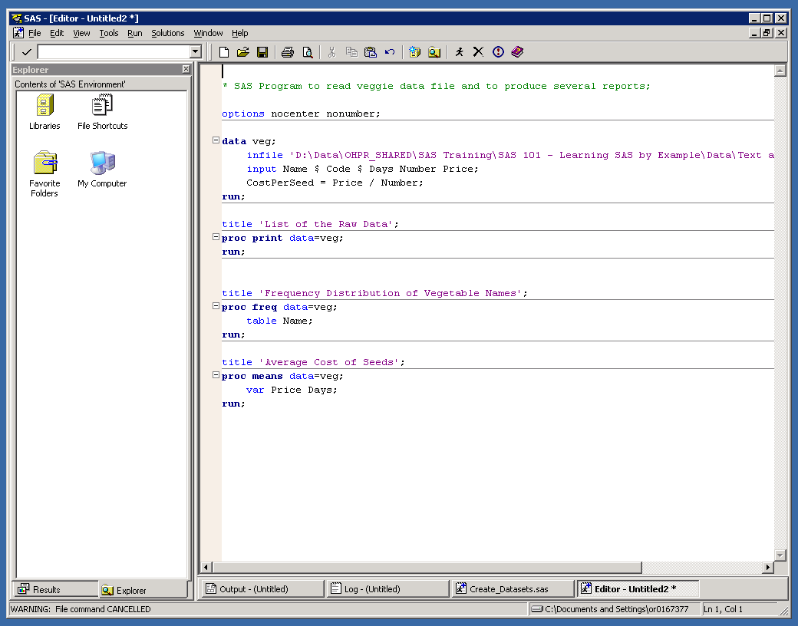
DATA steps:
Read and write data, manipulate data, perform calculations, etc.
Every DATA step creates a new dataset

Slide 15
Every SAS program can have multiple DATA and PROC steps
PROC steps:
Produce reports, summarize data, sort data,
create formats, generate graphs, etc. etc. etc.

Slide 16
Global statements:
Remain in effect until changed by another global statement or SAS session ends
Examples:
Titles, Footnotes, Options, Macros, Libname

Slide 17
Comment statements:
Ignored by SAS when code is run
Used to write comments to yourself or others or
comment out code you don’t want to run
*comment statement;
or
/* comment statement */
Notes:
Wajdi Ben Saad

Slide 18
Programming in SAS
SAS is generally forgiving
  Code can be written on a single line or multiple lines
  Code and variable names not case sensitive
  Even accepts some misspellings
  Fi The Doo
Semicolons are super important
Colors of Enhanced Editor
Always check your log!!!
Often many ways to do the same thing

Slide 19
DATA STEP EXAMPLES

Slide 20
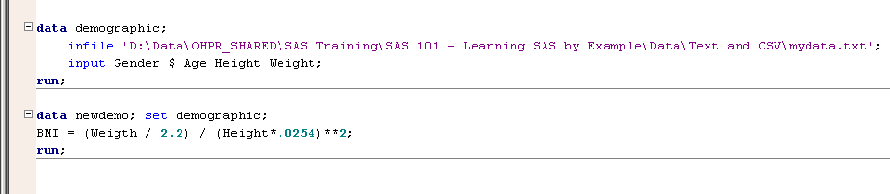
DATA step examples

Slide 21
DATA step examples
  DATA demographic
  “DATA demographic” creates a dataset called “Demographic”
  Infile statement reads the text file with the data
  Input statement tells SAS what to name the new variables. $ sign after “Gender” indicates that this is a character variable. The remaining variables are numeric.

Slide 22
DATA step examples
  DATA newdemo
  “DATA newdemo” creates a dataset called “newdemo”
  “SET demographic” references the previous dataset “demographic” as the basis for the new dataset
  “BMI =” creates a new variable called “BMI” that is calculated as shown. This is called an assignment statement.

Slide 23
PROC STEP EXAMPLES

Slide 24

PROC step examples

Slide 25
PROC step examples
  PROC freq
  Creates a basic frequency table with:
    Frequency
    Percent
    Cumulative Frequency
    Cumulative Percent
  “DATA=newdemo” references the newdemo dataset
  TABLE statement indicates which variable(s) to include
  Can use multiple variables and even create cross-tab tables

Slide 26
PROC step examples
  PROC means
  Creates a basic summary table with:
    N
    Mean
    Std Dev
    Minimum
    Maximum
  Can specify which statistics to use in table
  “DATA=newdemo” references the newdemo dataset
  VAR statement indicates which variable(s) to include

Slide 27
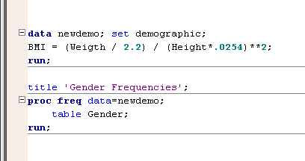
Other notes
Step boundaries:
Each step is executed when a step boundary is encountered
Explicit step boundary: RUN or QUIT statement
Implicit step boundary: Beginning of a new PROC or DATA step
Good SAS programmers use EXPLICIT step boundaries

Slide 28
Other notes
Referencing datasets:
Most procedures and DATA steps reference an existing dataset
Explicit dataset reference: DATA= or SET statement
Implicit dataset reference: If not explicitly referenced, SAS will use the last referenced dataset
Good SAS programmers use EXPLICIT dataset references

Slide 29
SAS HELP

Slide 30

http://www.sascommunity.org/wiki/
Learning_SAS_-_Resources_You_Can’t_Live_Without
Where to learn more about SAS
Technical papers
SAS User Groups
Websites
Books
Classes

Slide 31
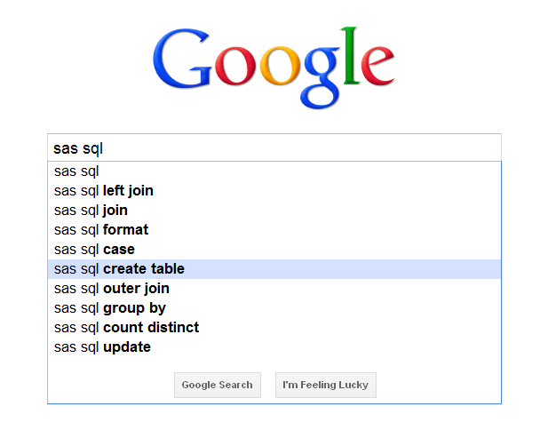
www.google.com

Slide 32
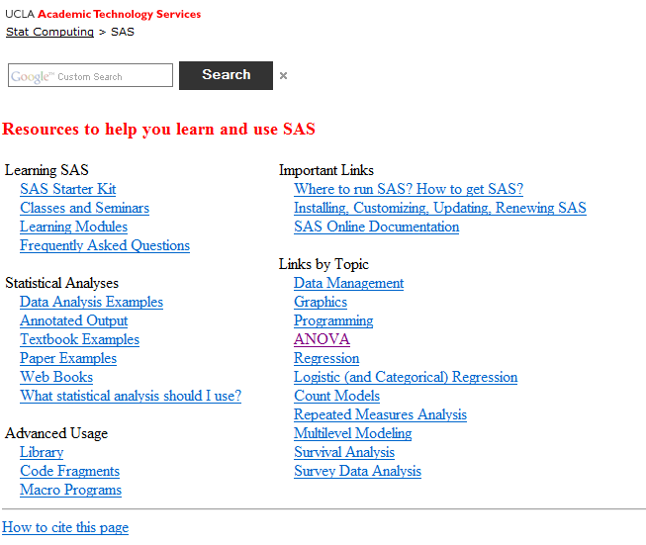
www.ats.ucla.edu/stat/sas

Slide 33
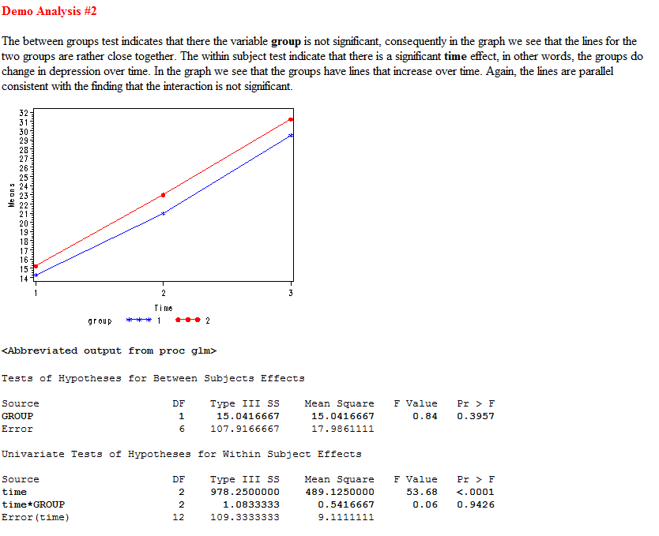
www.ats.ucla.edu/stat/sas
Explains both the stats and the SAS code

Slide 34
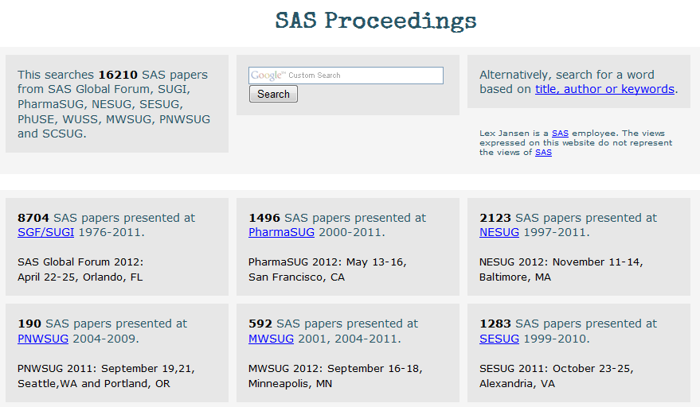
www.lexjansen.com

Slide 35
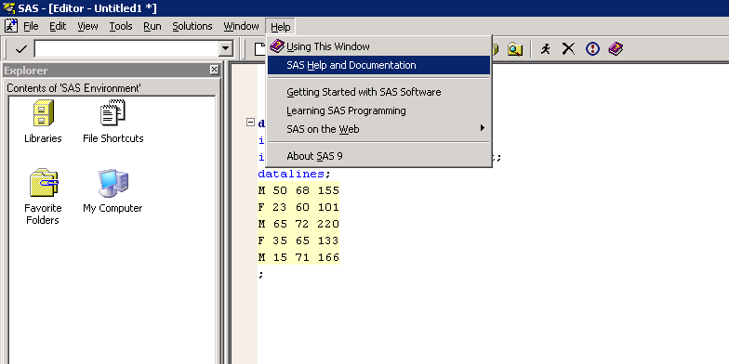
SAS Help and Documentation

Slide 36
How to read SAS Documentation
DATA output-SAS-data-set
(DROP=variable(s) | KEEP=variable(s));
SET SAS-data-set <options>;
BY variable(s);
RUN;

Slide 37
How to read SAS Documentation
DATA output-SAS-data-set
(DROP=variable(s) | KEEP=variable(s));
SET SAS-data-set <options>;
BY variable(s);
RUN;
DATA, DROP=, KEEP=, SET, BY, and RUN are in uppercase bold because they must be spelled as shown.

Slide 38
How to read SAS Documentation
DATA output-SAS-data-set
(DROP=variable(s) | KEEP=variable(s));
SET SAS-data-set <options>;
BY variable(s);
RUN;
output-SAS-data-set, variable(s), SAS-data-set, and options are in italics because each represents a value that you supply.

Slide 39
How to read SAS Documentation
DATA output-SAS-data-set
(DROP=variable(s) | KEEP=variable(s));
SET SAS-data-set <options>;
BY variable(s);
RUN;
<options> is enclosed in angle brackets because it is optional syntax.

Slide 40
How to read SAS Documentation
DATA output-SAS-data-set
(DROP=variable(s) | KEEP=variable(s));
SET SAS-data-set <options>;
BY variable(s);
RUN;
DROP= and KEEP= are separated by a vertical bar ( | ) to indicate that they are mutually exclusive.

